Slide 1
A Survey on Recommender Systems
Research Discussion Mingzhe Du 05/04/2016

Slide 2
Categories
Content-Based Recommender
User- User Collaborative Filtering
Item-Item Collaborative Filtering
Non-Personalized Recommender

Slide 3
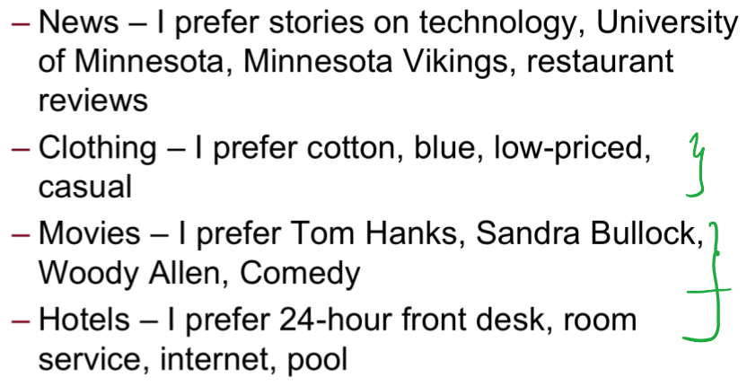
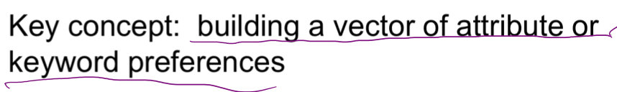
Content-Based Rec.
Recommend New Items before Being Rated

Slide 4
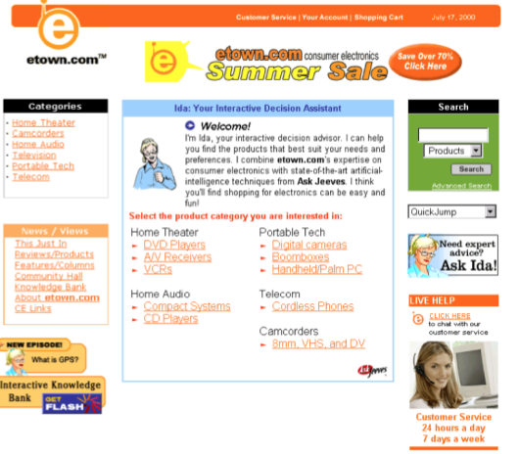
Content-Based Rec.
Case-based: Use Interview Process to elicit users preference

Slide 5
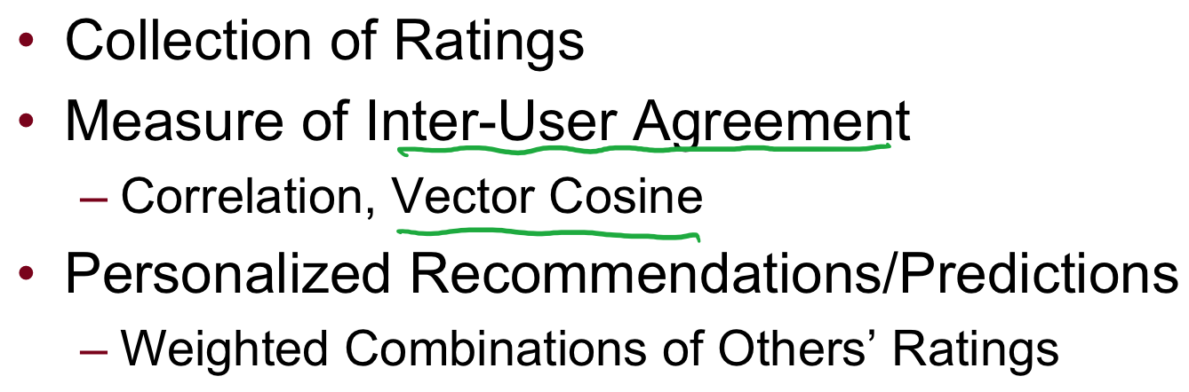
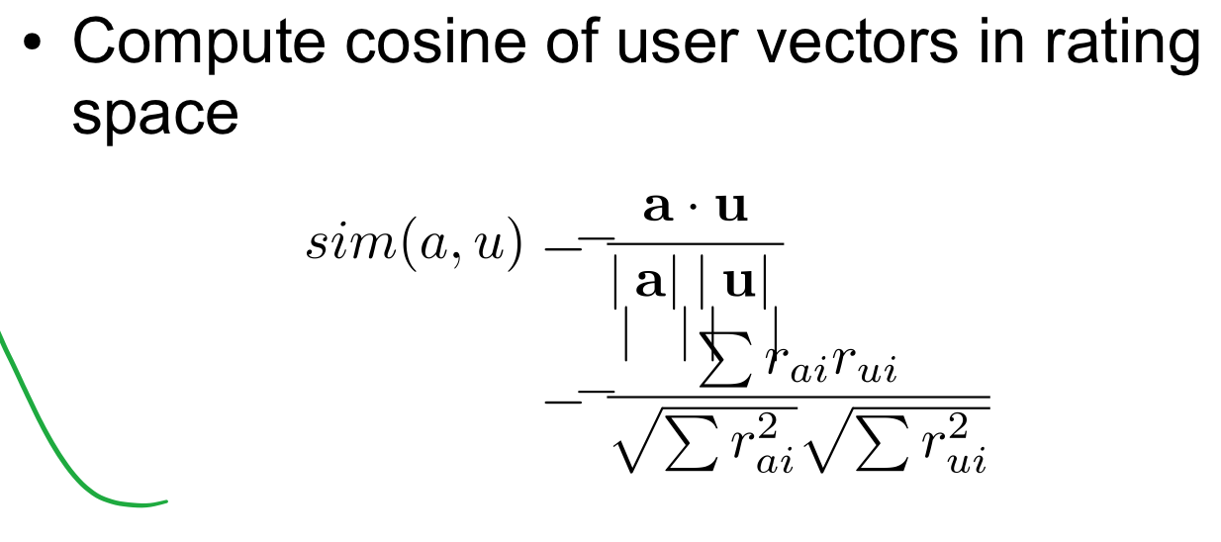
User-User Collaborative Filtering

Slide 6
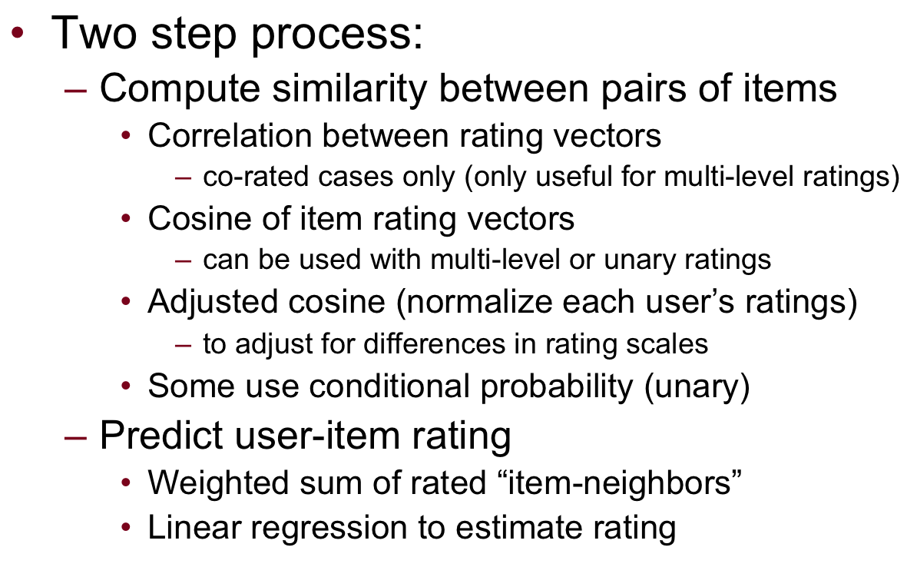
Item-Item Collaborative Filtering

Slide 7
Non-Personalized
Examples:
TripAdvisor travel reviews and ratings
Billborad Top 100
Yelp Resturant Recommendations

Slide 8
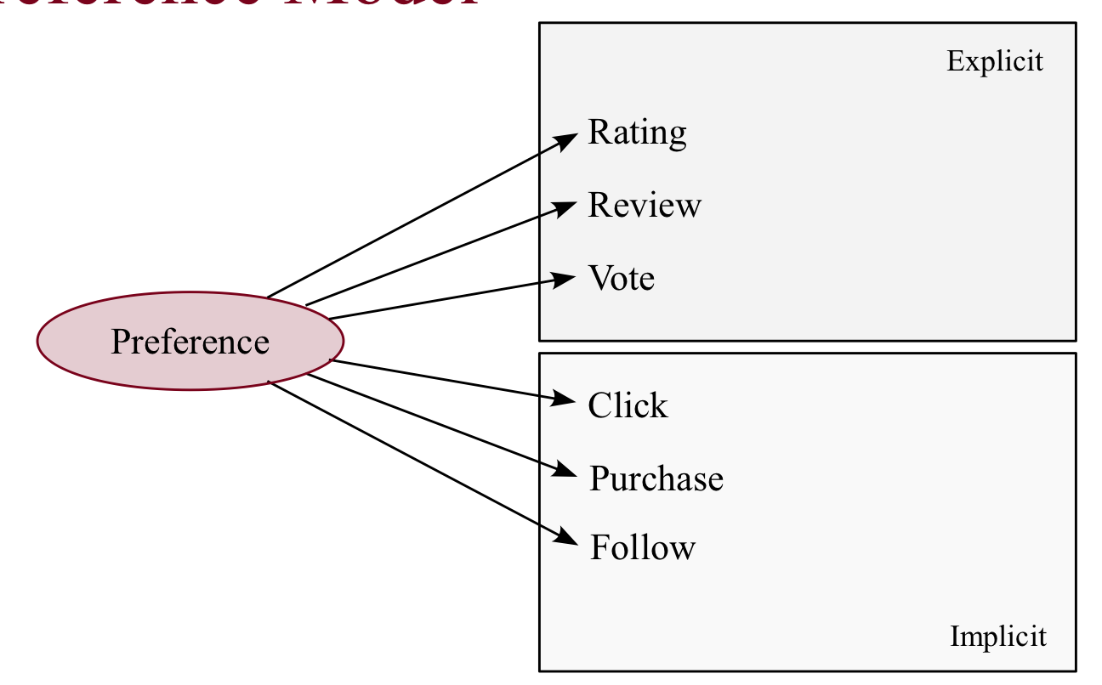
Non-Personalized
Preference and Ratings
Explicit
Star Ratings (NetFlix)
Thumbs Up and Down (Reddit)
Likes (Facebook)
Implicit
Data Collected from user actions:
Reading Time
Click on link
Purchase
Follow

Slide 9

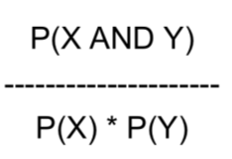
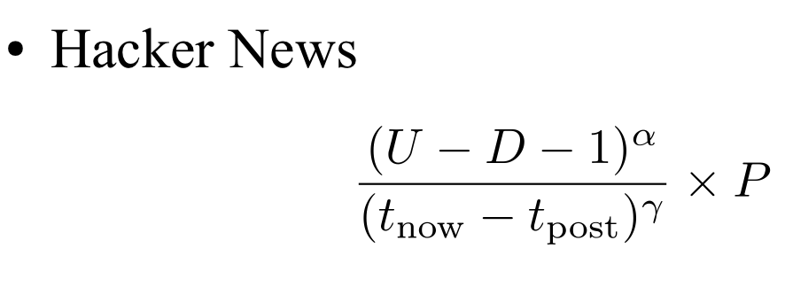
Non-Personalized
Algorithms:
1.
Averages can be misleading
2.
- 3. Hacker News

Slide 10
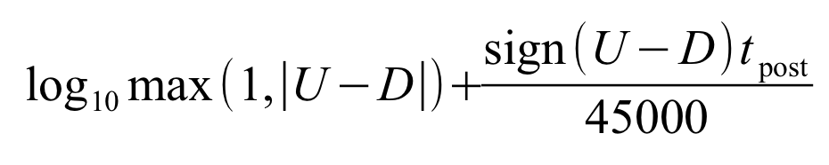
Non-Personalized
- 5. Reddit

Slide 11
Non-Personalized
Problems:
1. Prevent Cheating
2. Self-selection Bias
User credibility, click log
Notes:
In statistics, self-selection bias arises in any situation in which individuals select themselves into a group, causing a biased sample with nonprobability sampling. It is commonly used to describe situations where the characteristics of the people which cause them to select themselves in the group create abnormal or undesirable conditions in the group. It is closely related to the Non-response bias, describing when the group of people responding has different responses than the group of people not responding.

Slide 12
Reference
Introduction to Recommender Systems, Coursera Course
Deconstructing Recommender System http://spectrum.ieee.org/computing/software/deconstructing-recommender-systems
A Survey on Recommender System
Hacker News Ranking Algorithm
Reddit’s News Ranking Algorithm
Reddit’s Comment Ranking Algorithm

